Slide 1

Mobile Intelligent Robotic Arm Interface (MIRAI)
TEAM MEMBERS
Team Member 1 :Aditya R Menon
Roll No: 2501630006 Contact: 9560900801
Team Member 2 Ayush Singh
Roll No: 2501630012 Contact: 917303930312
Team Member 2 Ajitesh Singh Gusain
Roll No: 2501630014 Contact: 9871230184
MENTOR
Dr. Kishore Ayyala Ajay Kumar
K.R. Mangalam University | School of Engineering & Technology

Slide 2
Problem Statement & Goal
!
The Problem
✓
Our Goal
Most low-cost robotic arms are either fully manual or attempt full autonomy in one leap — making them hard to validate, debug, and defend as a working system.
There is no gradual, testable pathway from a simple manipulator to an autonomous mobile robot that a student team can realistically build stage by stage.
Develop a 6-DOF robotic arm mounted on an omnidirectional mobile platform that gradually evolves — across three clearly defined stages — from a manually controlled manipulator into a fully autonomous pick-and-place robot.
Current focus: STAGE 1 — proving the arm can physically perform accurate manipulation before adding mobility or autonomy.
Progressive Development of an Autonomous Omnidirectional Robotic Arm
2

Slide 3
Project Development Pipeline
Three progressive stages — each stage validates one capability before the next is added.
CURRENT STAGE
1
2
3
Fixed Robotic Arm
Mobile Omnidirectional Arm
Autonomous Mobile Manipulator
Manual Pick & Place
Manual Navigation + Manipulation
Vision + ROS 2 + SLAM + Navigation
Stationary 6-DOF arm, camera-guided, manually controlled.
Arm mounted on an omnidirectional chassis, still manually driven.
Fully autonomous pick, transport, and place.
Progressive Development of an Autonomous Omnidirectional Robotic Arm
3

Slide 4
Stage 1 — Fixed Robotic Arm
Objective Build and validate the 6-DOF robotic arm as a stationary manipulator before introducing mobility or autonomy.
System Hardware
MAIN TASK
6-DOF robotic arm
6 servo motors
Servo driver
ESP32 microcontroller
ESP32-CAM / camera
Robotic gripper
Fixed base
Successfully pick a LEGO / object using the camera for detection, and place it at a new location — using fully manual control.
Testing Focus
Test all 6 DOF & servo movement
Arm positioning accuracy
Gripper opening / closing
Object picking & placement
Validate mechanical design
Progressive Development of an Autonomous Omnidirectional Robotic Arm
4

Slide 5
Stage 1 — pipline
Why Stage 1? Before making the robot autonomous, we must prove the arm itself can physically perform accurate manipulation.
1
2
3
4
Object detected / observed
User controls arm
Arm moves to object
Gripper closes
5
6
7
8
Object picked
Arm moves to destination
Gripper opens
Object placed successfully
Progressive Development of an Autonomous Omnidirectional Robotic Arm
5

Slide 6
Components List — Stage 1
Servo Driver | PCA9685 16-Channel Servo Driver | 1 | ₹480 | ₹480
Power Converter | XL4015 5A Buck Converter | 1 | ₹249 | ₹249
Power Source | 3S LiPo Battery 2200mah ,11.1v | 1 | ₹1,899 | ₹1,899
 | Robocraze iMAX B6 Digital Balance Charger | 1 | ₹2,689 | ₹2,689
 | X60 connectors | 1 | ₹63 | ₹63
For extending the servo wires | 30CM Servo Extension Cable Pack | 1 | ₹299 | ₹299
Wiring & Base | Male-female jumper wires | 1 Pack | ₹200 | ₹200
For wire protection and covering | Shrink warp | 10 | ₹139 | ₹139
Category | Component Name | Qty | Unit Price | Total Cost
Actuators | MG996R 180° Servos (torque) (9.4 kgf·cm 4.8V | 3 | Pack of four motors | ₹1,317
Actuators | MG90S (metal-gear) Servos(2.2 kg·cm ) | 3 | ₹600 | ₹439
For circuit connections | Breadboard full size | 1 | ₹200 | ₹200
Main Brain | ESP32 Development Board | 1 | ₹342 | ₹342
 | GPIO expansion board | 1 | ₹219 | ₹219
Vision Input | ESP32 CAM Development Board | 1 | ₹229 | ₹229
 | ESP32-CAM (with OV2640) | 1 | ₹849 | ₹849
6

Slide 7
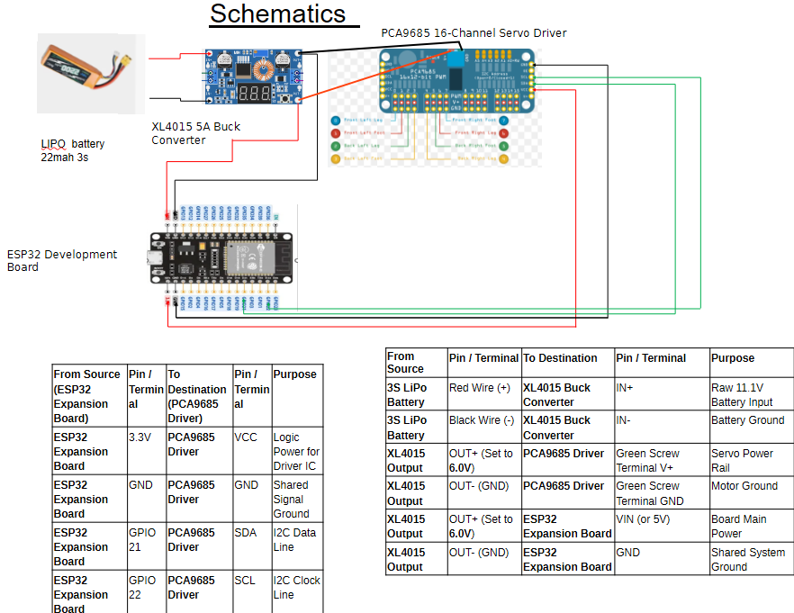

Slide 8
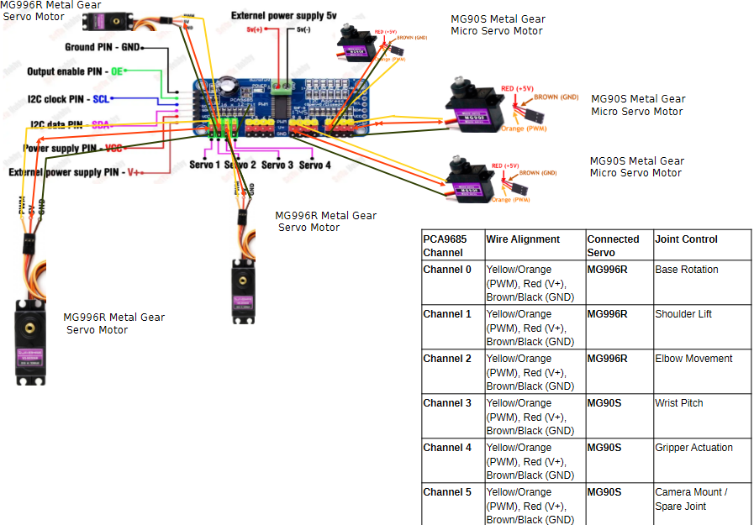

Slide 9
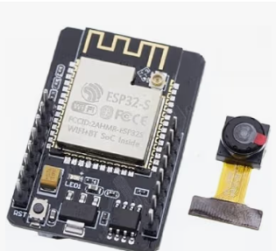
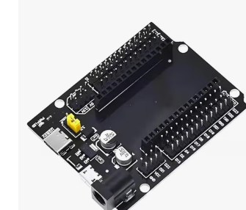
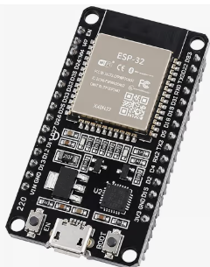
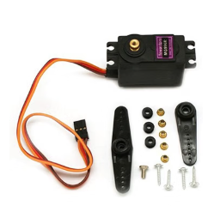
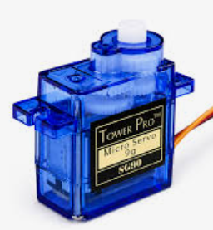
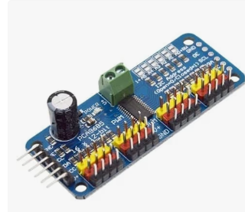
Components Used
ESP32 Development Board
ESP32-CAM Module (OV2640)
GPIO Expansion Board
MG996R Servo Motor
SG90 Micro Servo Motor
PCA9685 Servo Driver
Progressive Development of an Autonomous Omnidirectional Robotic Arm
7

Slide 10
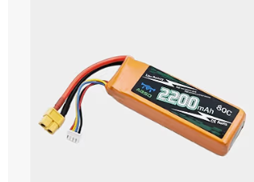
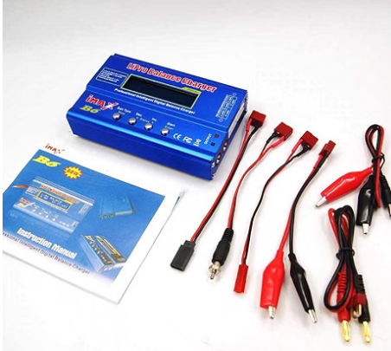
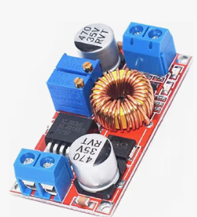
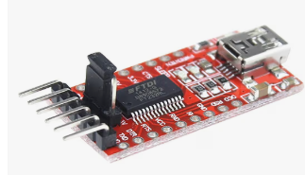
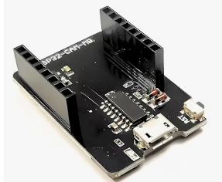
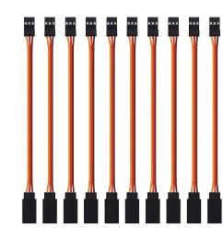
Components Used
3S LiPo Battery (2200mAh)
iMAX B6 Balance Charger
XL4015 Buck Converter
FTDI Programmer (USB-TTL)
ESP32-CAM Extension Board
Servo Extension Cables
Progressive Development of an Autonomous Omnidirectional Robotic Arm
8

Slide 11
Thank You

